Slide 1
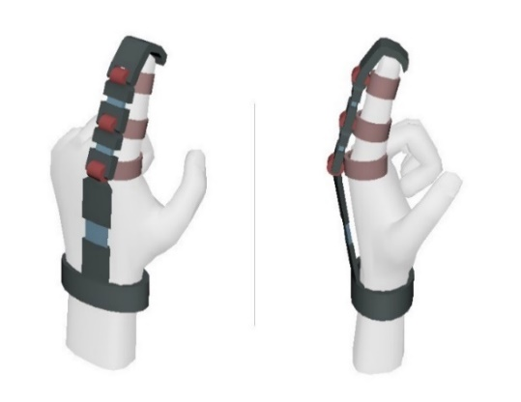
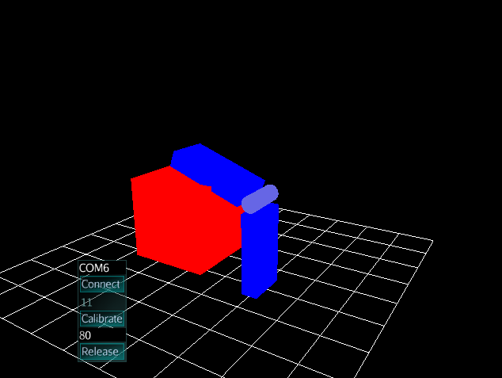
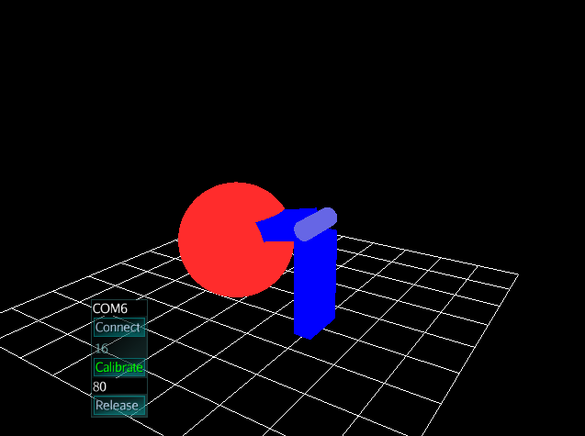
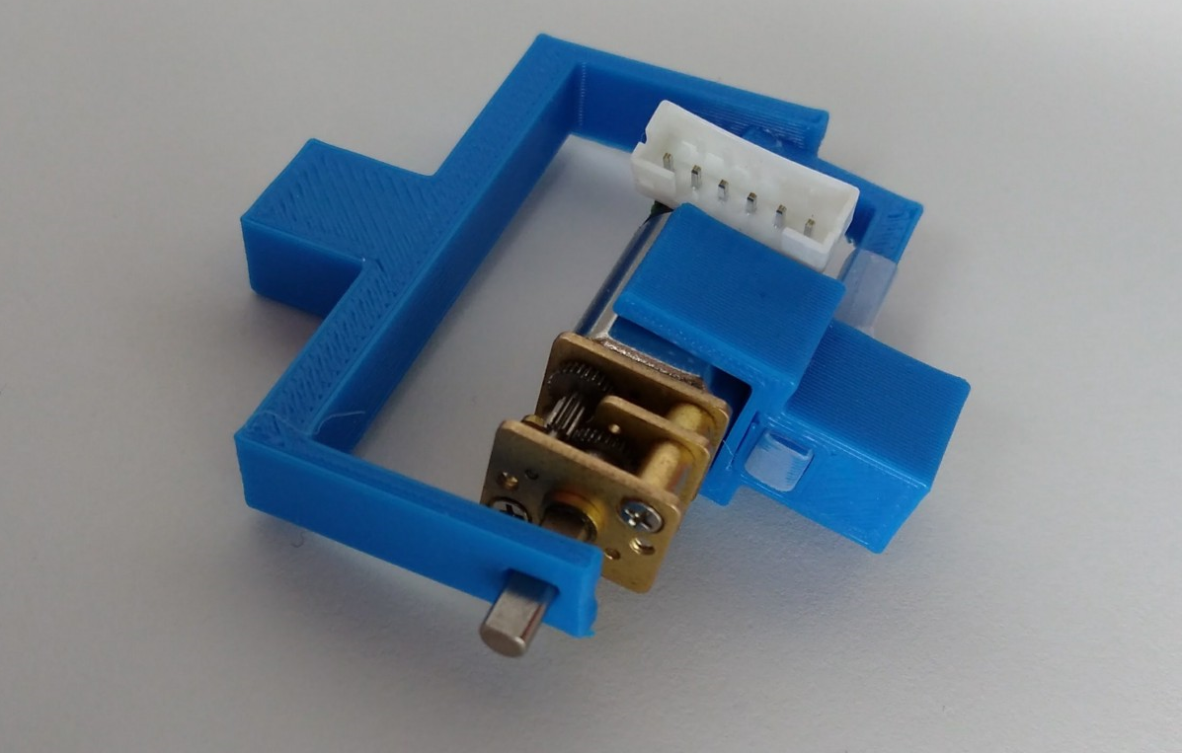
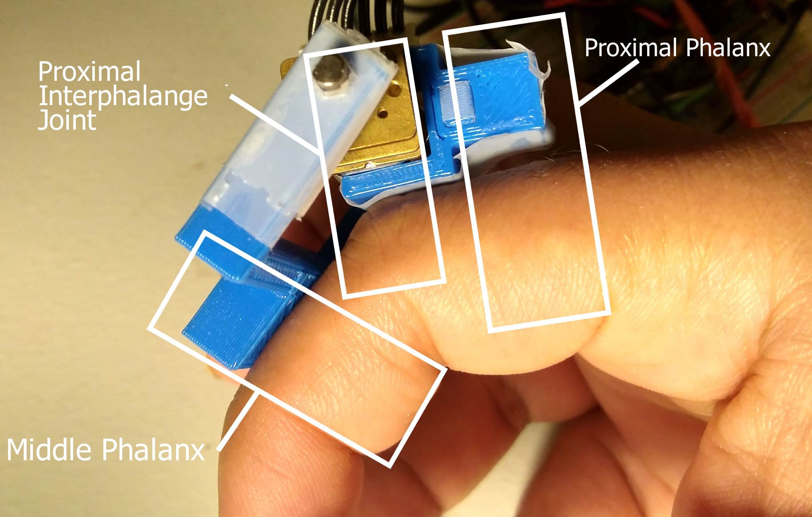
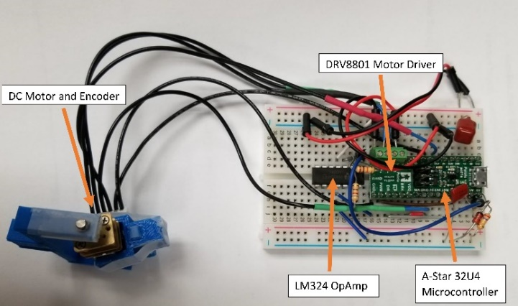
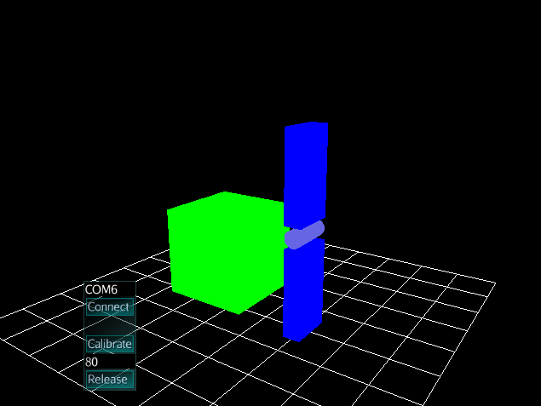
Building a VR Glove on Virtual Reality Platform
Quazi Irfan, Calvin Kielas-Jensen, Zhen Ni
Electrical Engineering and Computer Science Department
South Dakota State University
Brookings, SD 57007
Email: quazi.irfan, calvin.kielasjensen, zhen.ni @ sdstate.edu
Overview
Flowchart of Hardware and Software
Virtual reality (VR) technologies allow users to experience virtual environments in lifelike fidelity, but current generation input/output devices are not sophisticated enough to allow user to interact with the virtual environment.
Most of the currently available VR gloves only track finger translation, very few generate haptic feedback.
The goal of this project was to design and build a single VR-haptic feedback joint.
The left is the flowchart of the firmware running on the A-Star 32U4 and the right is the flowchart of the game engine on the PC.
Proposed Method
Build one physical joint that can track finger rotation and can generate haptic feedback.
Build a 3D game to visualize the joint movement.
Detect if virtual fingers are colliding with virtual objects.
Produce a reasonable amount of
torque when a collision is detected.
Emulate interaction with both hard and soft virtual objects.
Interaction with Hard and Soft Objects
When the virtual joint meets a hard virtual object, maximum torque (blue line) is applied on the motor to prevent the physical finger from going through the obstacle.
When the virtual joint meets a soft obstacle (i.e. an exercise ball), initially a very small amount of torque is applied, and gradually larger torque are applied as the finger goes deeper into the ball.
Physical Setup
3D printed joint housing a brushed DC motor and an encoder.
The joint sits on top of the proximal interphalangeal joint (PIJ) of the index finger.
The encoder measures the angular movement of the PIJ.
The motor is driven using an A-Star 32U4 microcontroller running a PID control loop to control the current, and in turn, the torque of the motor.
The microcontroller is connected to a PC that is running a game to visualize the virtual finger.
If the game engine detects collision between the virtual finger (blue) and the virtual obstacle (green box) instructions are sent to the microcontroller to produce torque, preventing the real finger from going through that object.
Proximal Interphalangeal Joint
Proximal Phalanx
Middle Phalanx
Software and Hardware Requirements
Java, jMonkeyEngine, OpenGL
Brushed DC motor, Incremental Encoder
A-Star 32U4, DRV8801
Conclusion
VR gloves with haptic feedback allow deeper immersion for the player in the virtual world.
Single joints behave like real finger joints.
In the future, two more joints will be added to track a full finger.
References:
[1] Lawrence W. Stark, "How Virtual Reality Works: Illusions of Vision in "Real" and Virtual Environments", Proc. SPIE 2411, Human Vision, Visual Processing, and Digital Display VI, (20 April 1995); doi: 10.1117/12.207546.
[2] Startups Are Building New Ways To Interact with Virtual Reality Rachel Metz - technologyreview.com/s/543316/the-step-needed-to-make-virtual-reality-more-real Accessed on Feb 25, 2018.
[3] Bain, G. I., Polites, N., Higgs, B. G., Heptinstall, R. J., & McGrath, A. M. (2015). The Functional Range of Motion of The Finger Joints - Journal of Hand Surgery (European Volume), 40(4), 406–411. https://doi.org/10.1177/1753193414533754
[4] Tarn, T. J., A. K. Bejczy, A. Isidori, and Y. Chen. "Nonlinear feedback in robot arm control." In Decision and Control, 1984. The 23rd IEEE Conference on, vol. 23, pp. 736-751, 1984.
[5] Nise, Norman S., CONTROL SYSTEMS ENGINEERING, John Wiley & Sons, 2007
[6] Rocco, Paolo. "Stability of PID control for industrial robot arms." IEEE transactions on robotics and automation 12, no. 4 (1996): 606-614
For any question about this paper, please contact Dr. Ni for details.
This work is supported by Bennett Fellowship; Electrical Engineering and Computer Science Dept at SDSU
Notes:
- the margin I have left on each side is 1/2 inch
- each column is 15 inches separated from each other by 0.5 inch

